Slide 1
Chapter 3 Linear Regression

Slide 2
Basic Information about Linear Regression
Supervised Learning method
Predicting a quantitative response
Widely used statistical learning method
Serves as a good jump-off point for newer approaches.

Slide 3
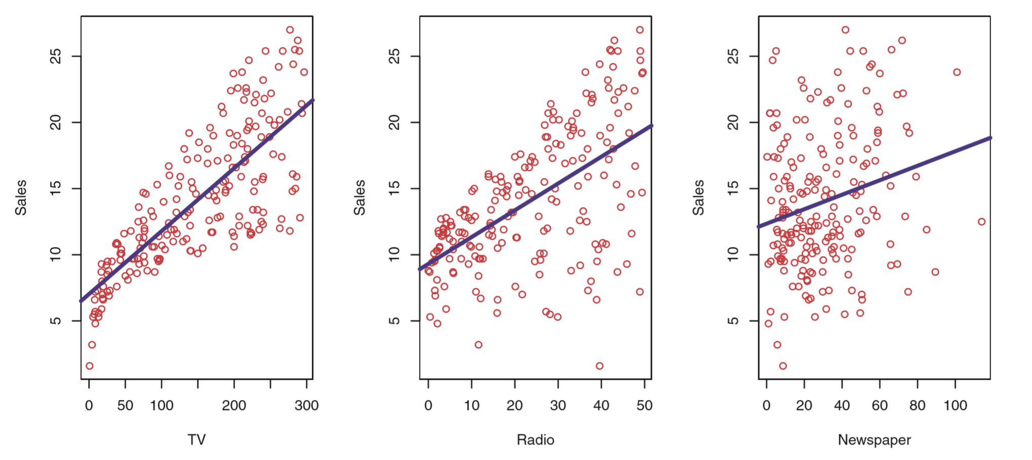
How to use Linear regression?
Using Advertising data from Chapter 2
Goal: suggest a market plan that will result in high product sales.

Slide 4
Important Questions we seek to address
Is there a relationship between advertising budget and sales?
How strong is the relationship between advertising budget and sales?
Which media contribute to sales?
How accurately can we estimate the effect of each medium on sales?
How accurately can we predict future sales?
Is the relationship linear?
Is there synergy among the advertising media?

Slide 5
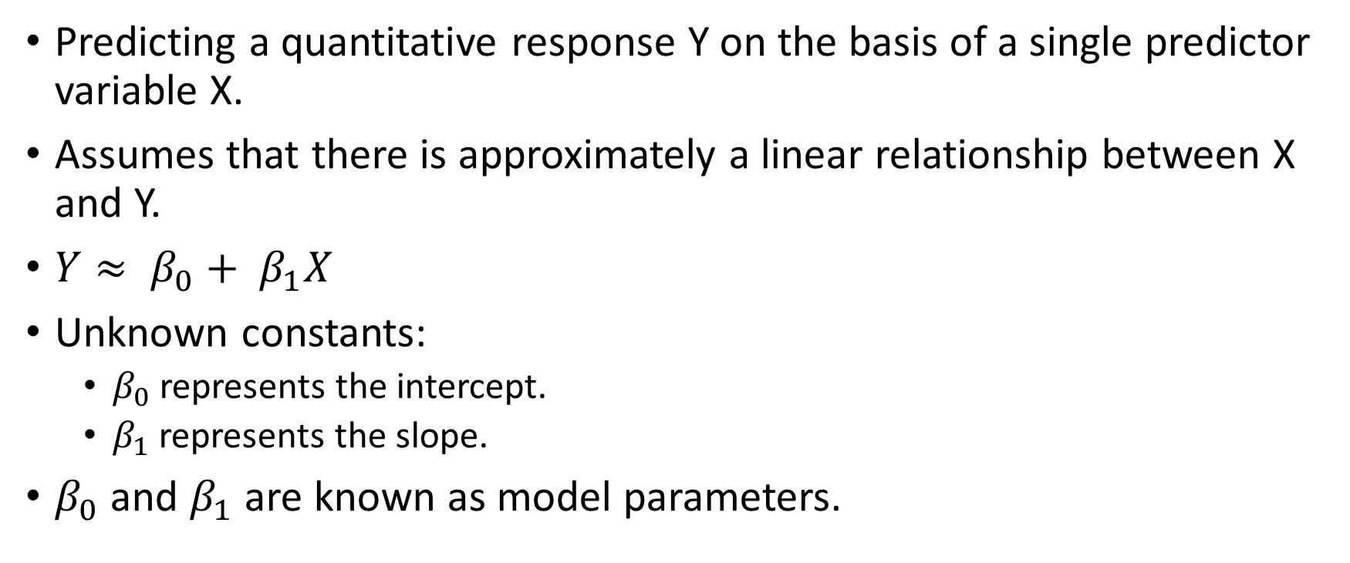
3.1 Simple Linear Regression
Predicting a quantitative response Y on the basis of a single predictor variable X.
Assumes that there is approximately a linear relationship between X and Y.
$Y≈ β_{0}+ β_{1}X$
Unknown constants:
$β_{0}$ represents the intercept.
$β_{1}$ represents the slope.
$β_{0}$ and $β_{1}$ are known as model parameters.

Slide 6
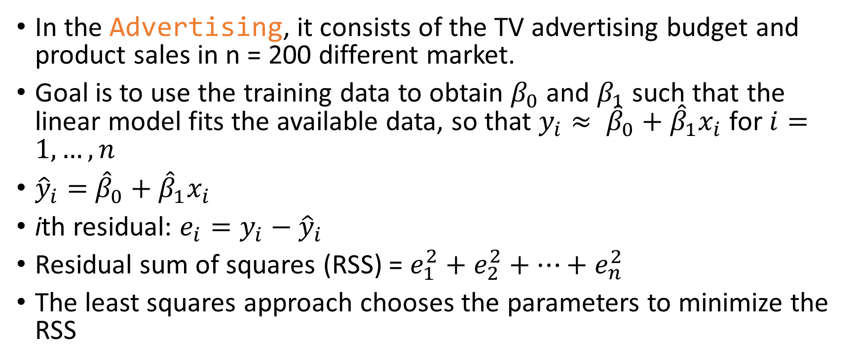
Estimating the Parameters
In the Advertising, it consists of the TV advertising budget and product sales in n = 200 different market.
Goal is to use the training data to obtain $β_{0}$ and $β_{1}$ such that the linear model fits the available data, so that $y_{i}≈ {\hat{β}}_{0}+{\hat{β}}_{1}x_{i}$ for $i=1, …, n$
${\hat{y}}_{i}=$ ${\hat{β}}_{0}+{\hat{β}}_{1}x_{i}$
ith residual: $e_{i}=y_{i}−{\hat{y}}_{i}$
Residual sum of squares (RSS) = $e_{1}^{2}+e_{2}^{2}+…+e_{n}^{2}$
The least squares approach chooses the parameters to minimize the RSS

Slide 7

${\hat{β}}_{1}=\frac{\sum_{i=1}^{n}{(x_{i}−\overline{x})(y_{i}−\overline{y})}}{\sum_{i=1}^{n}{{(x_{i}−\overline{x})}^{2}}}= \frac{Cov(x,y)}{Var(x)}$
${\hat{β}}_{0}=\overline{y}−{\hat{β}}_{1}\overline{x}$ , ${\hat{β}}_{0}$ is a constant and is set at such that the line passes through the coordination ($\overline{x}$ , $\overline{y}$).
$\overline{y}$ and $\overline{x}$ are sample means

Slide 8
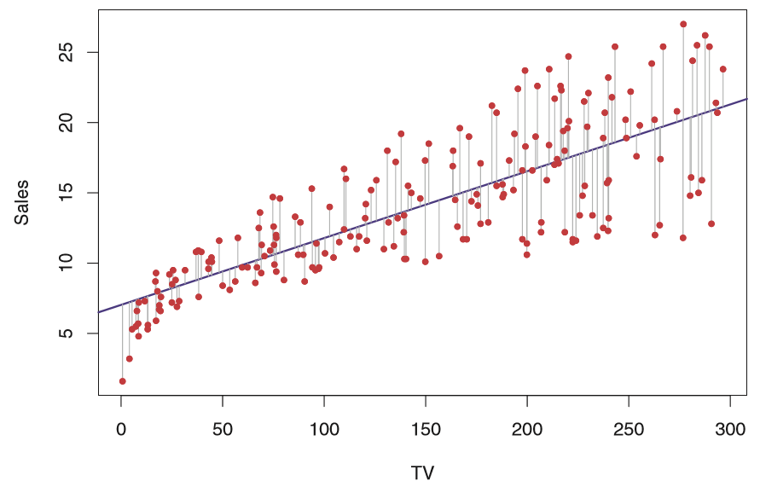

Slide 9
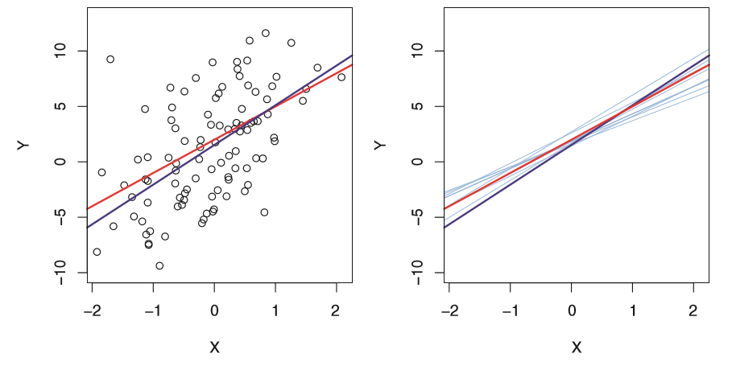

Population regression line
$Y=β_{0}+β_{1}X+ε$
Concept of using information from a sample to estimate characteristics of a large population.
Population mean: $μ$
The property of unbiasedness

Slide 10

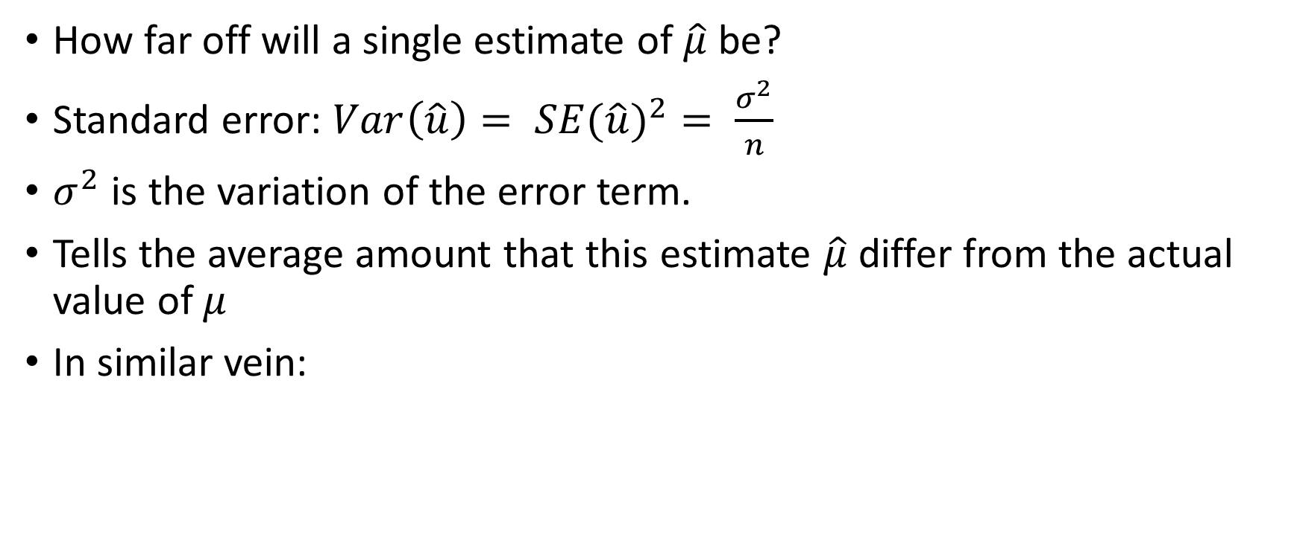
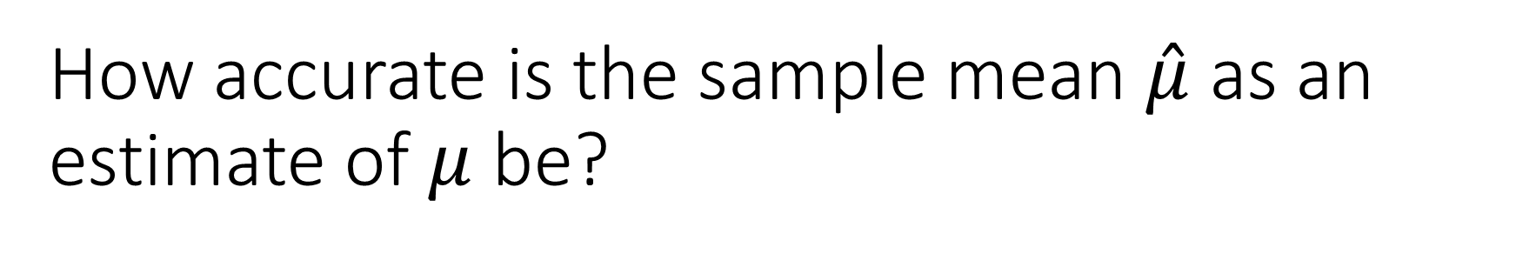
How accurate is the sample mean $\hat{μ}$ as an estimate of $μ$ be?
How far off will a single estimate of $\hat{μ}$ be?
Standard error: $Var\left(\hat{u}\right)= {SE(\hat{u})}^{2}= \frac{σ^{2}}{n}$
$σ^{2}$ is the variation of the error term.
Tells the average amount that this estimate $\hat{μ}$ differ from the actual value of $μ$
In similar vein:

Slide 11
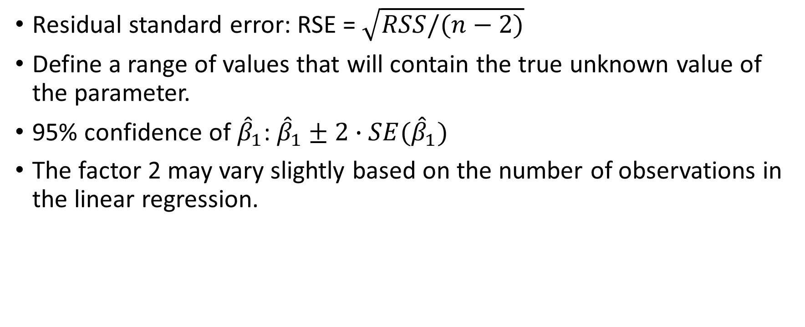
Confidence Interval
Residual standard error: RSE = $\sqrt{RSS/(n−2)}$
Define a range of values that will contain the true unknown value of the parameter.
95% confidence of ${\hat{β}}_{1}$: ${\hat{β}}_{1}±2∙SE({\hat{β}}_{1})$
The factor 2 may vary slightly based on the number of observations in the linear regression.

Slide 12
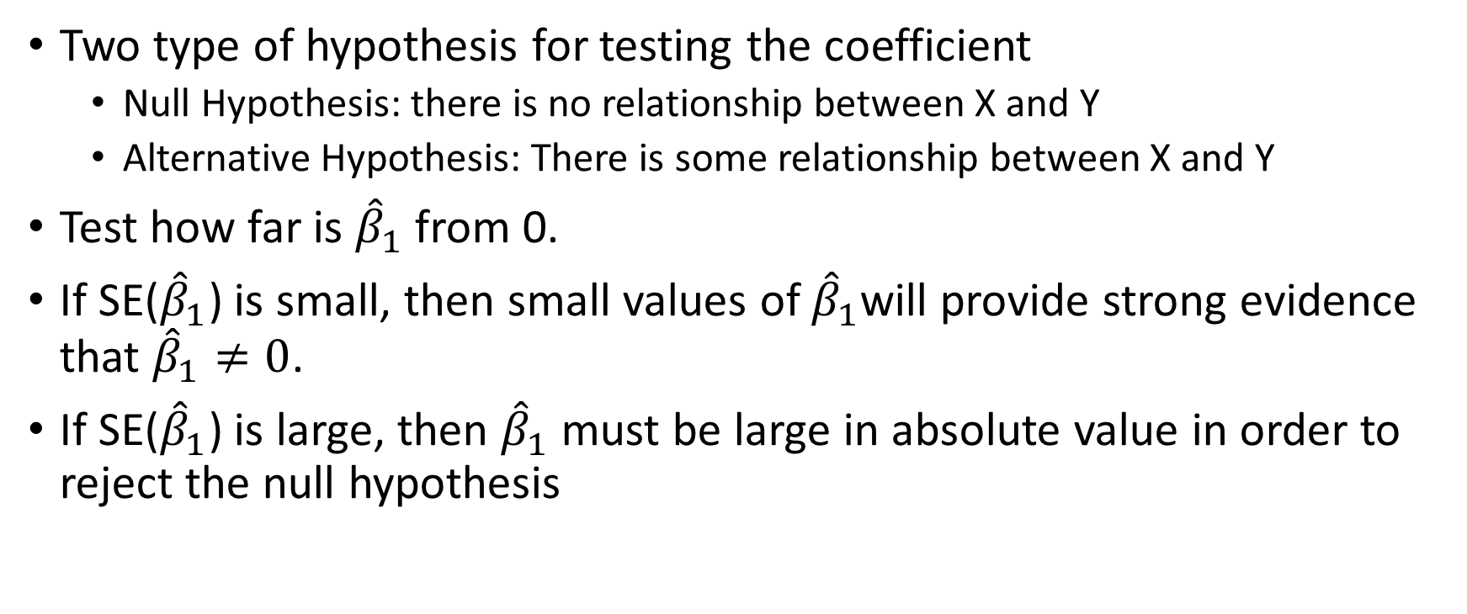
Hypothesis testing
Two type of hypothesis for testing the coefficient
Null Hypothesis: there is no relationship between X and Y
Alternative Hypothesis: There is some relationship between X and Y
Test how far is ${\hat{β}}_{1}$ from 0.
If SE(${\hat{β}}_{1}$) is small, then small values of ${\hat{β}}_{1}$will provide strong evidence that ${\hat{β}}_{1}≠0$.
If SE(${\hat{β}}_{1}$) is large, then ${\hat{β}}_{1}$ must be large in absolute value in order to reject the null hypothesis

Slide 13

Measure the number of standard deviation that ${\hat{β}}_{1}$ is away from 0:
$t=\frac{{\hat{β}}_{1}−0}{\text{SE}\text{(}{\hat{β}}_{1}\text{)}}$
T-statistic

Slide 14
T statistic
It is a probability distribution that is used to estimate population parameters
when the sample size is small or the population variance is unknown.
If there really is no relationship between X and Y, then expect that will have a t-distribution with n - 2 degrees of freedom

Slide 15
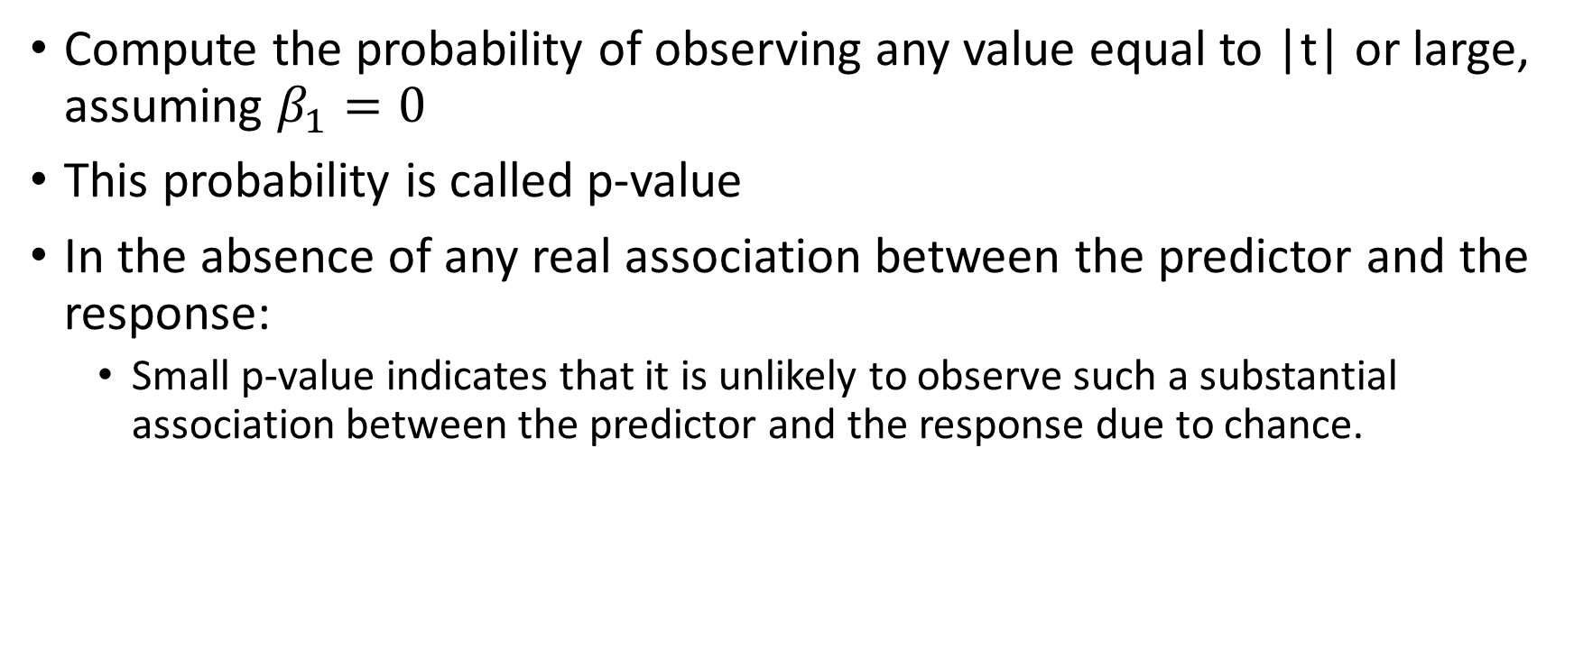
T distribution
Compute the probability of observing any value equal to |t| or large, assuming $β_{1}=0$
This probability is called p-value
In the absence of any real association between the predictor and the response:
Small p-value indicates that it is unlikely to observe such a substantial association between the predictor and the response due to chance.

Slide 16
If the p-value is small enough, we can infer that there is an association between the predictor and the response.
Therefore, rejects Null hypothesis, because there is a relationship between X and Y.
Typically, p-value cutoffs for rejecting null hypothesis is 1%

Slide 17
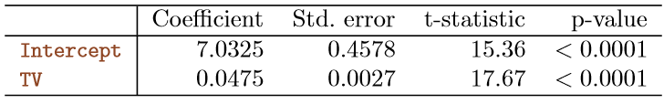
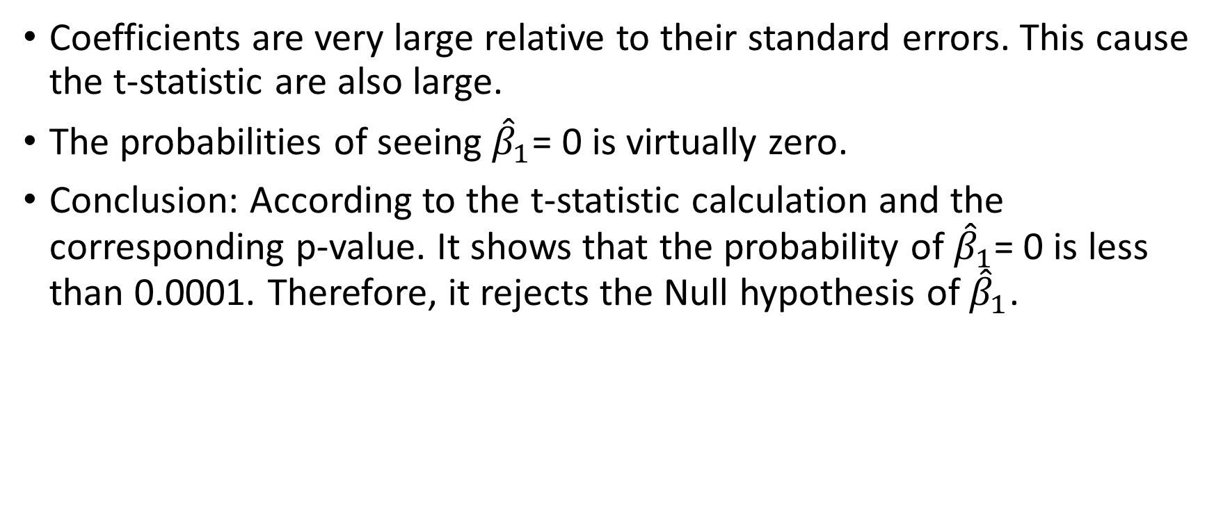
Coefficients are very large relative to their standard errors. This cause the t-statistic are also large.
The probabilities of seeing ${\hat{β}}_{1}$= 0 is virtually zero.
Conclusion: According to the t-statistic calculation and the corresponding p-value. It shows that the probability of ${\hat{β}}_{1}$= 0 is less than 0.0001. Therefore, it rejects the Null hypothesis of ${\hat{β}}_{1}$.

